Slide 1
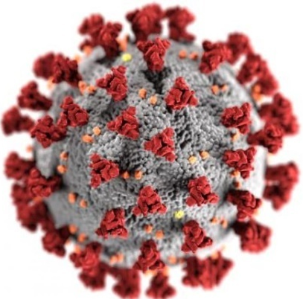
How much do we know about the invisible Enemy?
COVID-19
Dr. Quazi Tarikul Islam
Professor of Medicine
Member, National Technical Advisory Committee on COVID-19
prof.tarik@gmail.com

Slide 2
CONTENTS
Introduction
Epidemiology
Pathogenesis
Case definition
Clinical manifestations
Investigations
Management

Slide 3
Introduction
During any pandemic, new information circulate (Infodemic).
While many of these new information are facts, some are far from it.
Especially in this age of technology and internet, correct information along with rumors can spread like wildfire in the blink of an eye.
This presents as one of the challenges in the successful handling of the latest pandemic, the Covid-19.

Slide 4
CASE 1
A 69 year old man had 2 days low grade temperature without cough, sore throat and SOB had severe fatigue only passed 7 days at home.
He was checking saturation at home which remains between 95 – 96% so he did not do any investigations. On 9th day of illness he has been investigated for RT-PCR for COVID came negative. On 10th day CRP, Ferritin, LDH, D-dimer and HRCT Lung. All investigations were very high with HRCT chest shows 60 % of lung infiltrates as GGO and crazy paving.
Contd....

Slide 5
CASE 1
He was treated as COVID pneumonia initialy moderate then severe type. Treated with Enoxaparin, Ramdisivir, Antibiotics, Oxygen therapy and Steroid. Oxygen requirement went up to 10-12 liters which came down to 2 liters /min. Patient also got Inj. Tocilizumab 2 shots in 12 hours apart. All the parameters of tests came down to normal except D-dimer which remains above 1000ng/ml. Lung shadow reduced to 25%.
Contd....

Slide 6
CASE 1
On 28 days of illness (18 days of treatment) he was put on DOAC and supportive drugs as he is hypertensive, Diabetic and history of PCI. 4 days after the oral drugs all investigations repeated lungs had 30-35% basal shadow with fibrotic changes and persistent high D-dimer. All other tests were normal. The patient stated complaining of more oxygen demand. From 2 liter it increases to 6 liters. HRCT chest done and it was a very bad picture involving 70% of lung. IgG titer for COVID was done came good titer positive.
Contd....

Slide 7
CASE 1
Further he was put on therapeutic dose of Enoxaparin, Steroid, Antifungal (Voriconazole),Antibiotics, Oxygen upto HFNC 40L/min. Sputum shows profuse growth of Klebsiella Pneum. He was deteriorating and at 92% of saturation he was put on Ventilator on 44th day of illness. Vitals were well maintained.
ANA,ENA profile, Anti Scl 70, Anti CCP ab, RA all were negative. On 50th day of illness lung shadow again improved with 30% shadow at base but total count is very high.

Slide 8
CASE 1
After putting on Ventilator all the following complications developed one after another in 15 days:
Pneumo mediastinum /Shock/AKI/ Hepatitis
Went on procedure of
Thoracic drain tube/HD/so many issues
Died on 67 day of illness

Slide 9
CASE 2
A 56 year non diabetic, non hypertensive businesswoman had body ache only on 5th April and did PCR which was positive on 9th April. She was treated symptomatic got well and came back to work after 3 weeks after PCR become negative. On 21st May she developed fever, dry cough. On 26th May she got admitted in to hospital and underwent following investigations. CXR, HRCT Lung, CBC,D-dimer, CRP, Ferritin, LDH. All investigations were in favor of COVID so PCR was done and came positive (2nd time).
Contd....

Slide 10
CASE 2
Enoxaparin, Remdisivir, Steroid, Toclizumab, CP, Oxygen therapy up to HFNC 50L/min failed to improve the clinical situation and was put on Ventilator on 4th June. In 48 hours of mechanical support she developed tachyarrythmia with increased Trop-i level. She developed cardiac arrest twice reversed with cardioversion but third arrest could not be reversed and the patient died.

Slide 11

WE MOURN
Hats Off to The Frontliners

Slide 12


Notes:
Total death of Bangladeshi doctor 56

Slide 13



Slide 14



Slide 15
Global: Health workers silenced, exposed and attacked
There is currently no systematic global tracking of how many health and essential workers have died after contracting COVID-19.
However, Amnesty International has collated and analyzed a wide range of available data that shows that over 7000 health workers are known to have died after contracting COVID-19 in around the world. September 3, 2020
According to Amnesty International’s monitoring, the countries with the highest numbers of health worker deaths thus far include the USA (507), Russia (545), UK (540), including 262 social care workers), Brazil (351), Mexico (248), Italy (188), Egypt (111), Iran (91), Ecuador (82) and Spain (63).
Health workers reported serious shortages of personal protective equipment (PPE) in nearly all of the 63 countries and territories surveyed by Amnesty International.
Amnesty International, July 13, 2020

Slide 16
A doctor working in Mexico City told Amnesty International that doctors were spending about 12% of their monthly salaries buying their own PPE.
In addition to a global shortage of supply, trade restrictions may have aggravated this problem. In June 2020, 56 countries and two trade blocs (the European Union and the Eurasian Economic Union) had put in place measures to either ban or restrict the export of some, or all, forms of PPE or its components.
Amnesty International documented several cases where health and essential workers experienced stigma and violence because of their jobs. For example, a nurse in Mexico was reportedly drenched with chlorine while walking on the street, and in the Philippines, attackers poured bleach in the face of a hospital utility worker.
TAKE ACTION AND ADD YOUR VOICE
Let’s Protect Health and Essential Workers Everywhere in the World
Amnesty International, July 13, 2020

Slide 17


Slide 18
Epidemiology
213 countries of the World affected
Male predominant
All age group are affected
Asymptomatic are super spreaders
Can affect all countries of cold , hot and humid

Slide 19
The first confirmed death from the corona virus infection occurred on 9 January.
Wuhan was placed under quarantine on January 23.
This raised intense attention in China and globally.
The WHO declared the COVID-19 outbreak a Public Health Emergency on January 30.
It spreads rapidly in china and other countries.

Slide 20
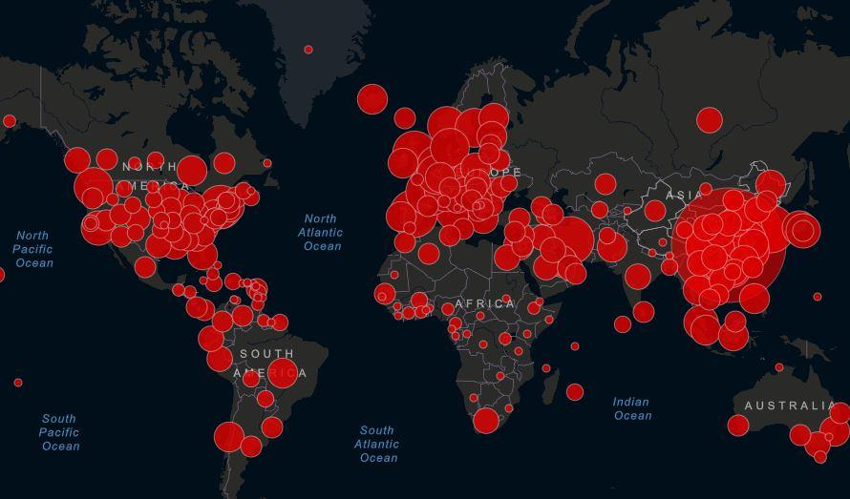

Slide 21
Case Detection and Case Fatality
Data from Worldometer does not reflect the actual figures from developed or developing countries globally. (07.9.2020)
C D TT POP INC Death TPT
USA- 6467458/193282/87571820/ 331314584 7.3 2.9 26.4
INDIA- 4236961/72033/49551507/1382159883 8.5 1.7 3.58
BANGLADESH- 327359/ 4516 /1644724/164949951 19.9 1.37 0.99
PAKISTAN- 298903 /6345/2778689/221554094 10.7 2.1 1.25
INC- Incidence , Death, TPT – Total population Tested in Percentage

Slide 22

In Bangladesh 1st case was reported on
March 08, 2020
It has already cost thousands of life and is a national burden both in health sector and in economic sector

Slide 23
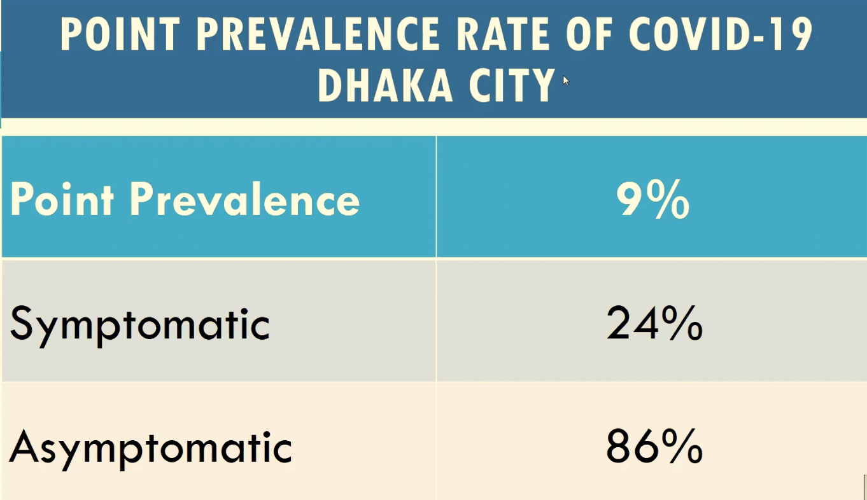
Bangladesh as on 24 August,2020

Slide 24
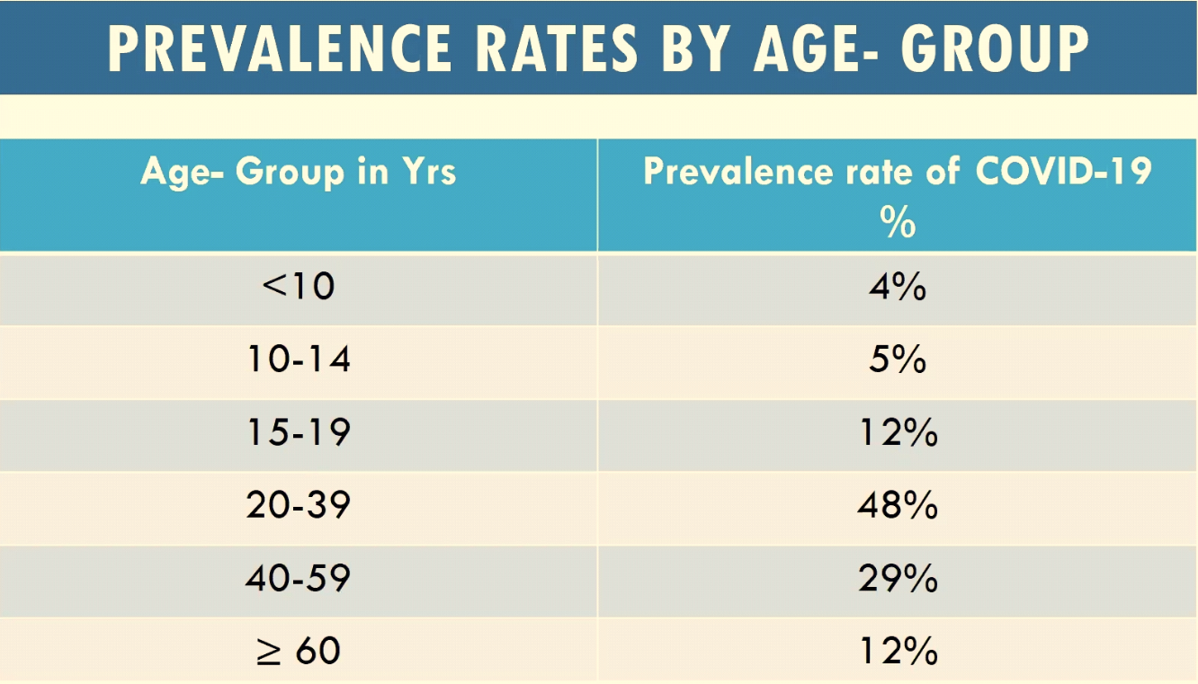
Bangladesh as on 24 August,2020

Slide 25
Pathogenesis
CRS: Gama Interferon/ TNF alpha/ IL1/IL6
Chemokines: Many
Coagulopathy: Clot in vessels of body Venous more than 70%
All these came to light in April after 50 cases of
postmortem in Italy.
ACE2 receptors are the target of COVID 19
Diffuse alveolar damage/ Type 2 Pneumocytes

Slide 26
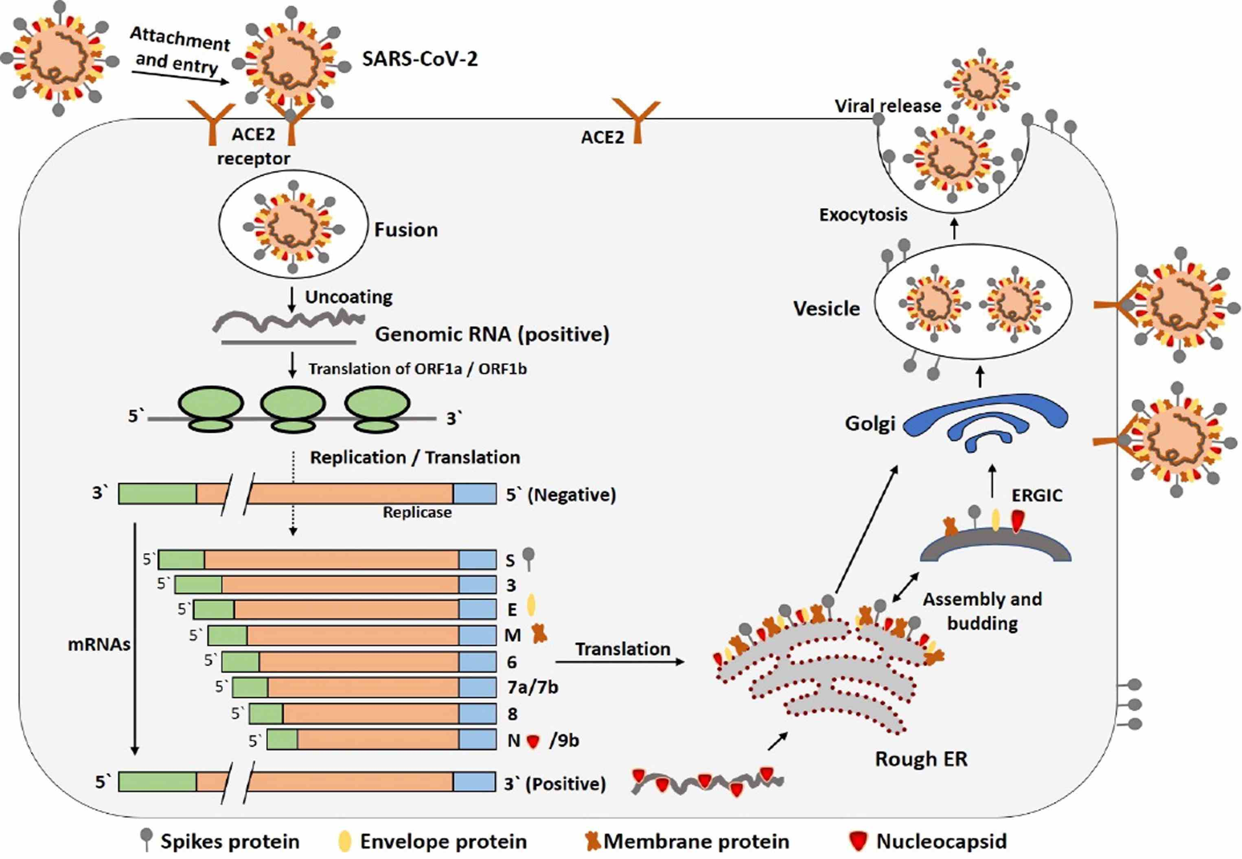
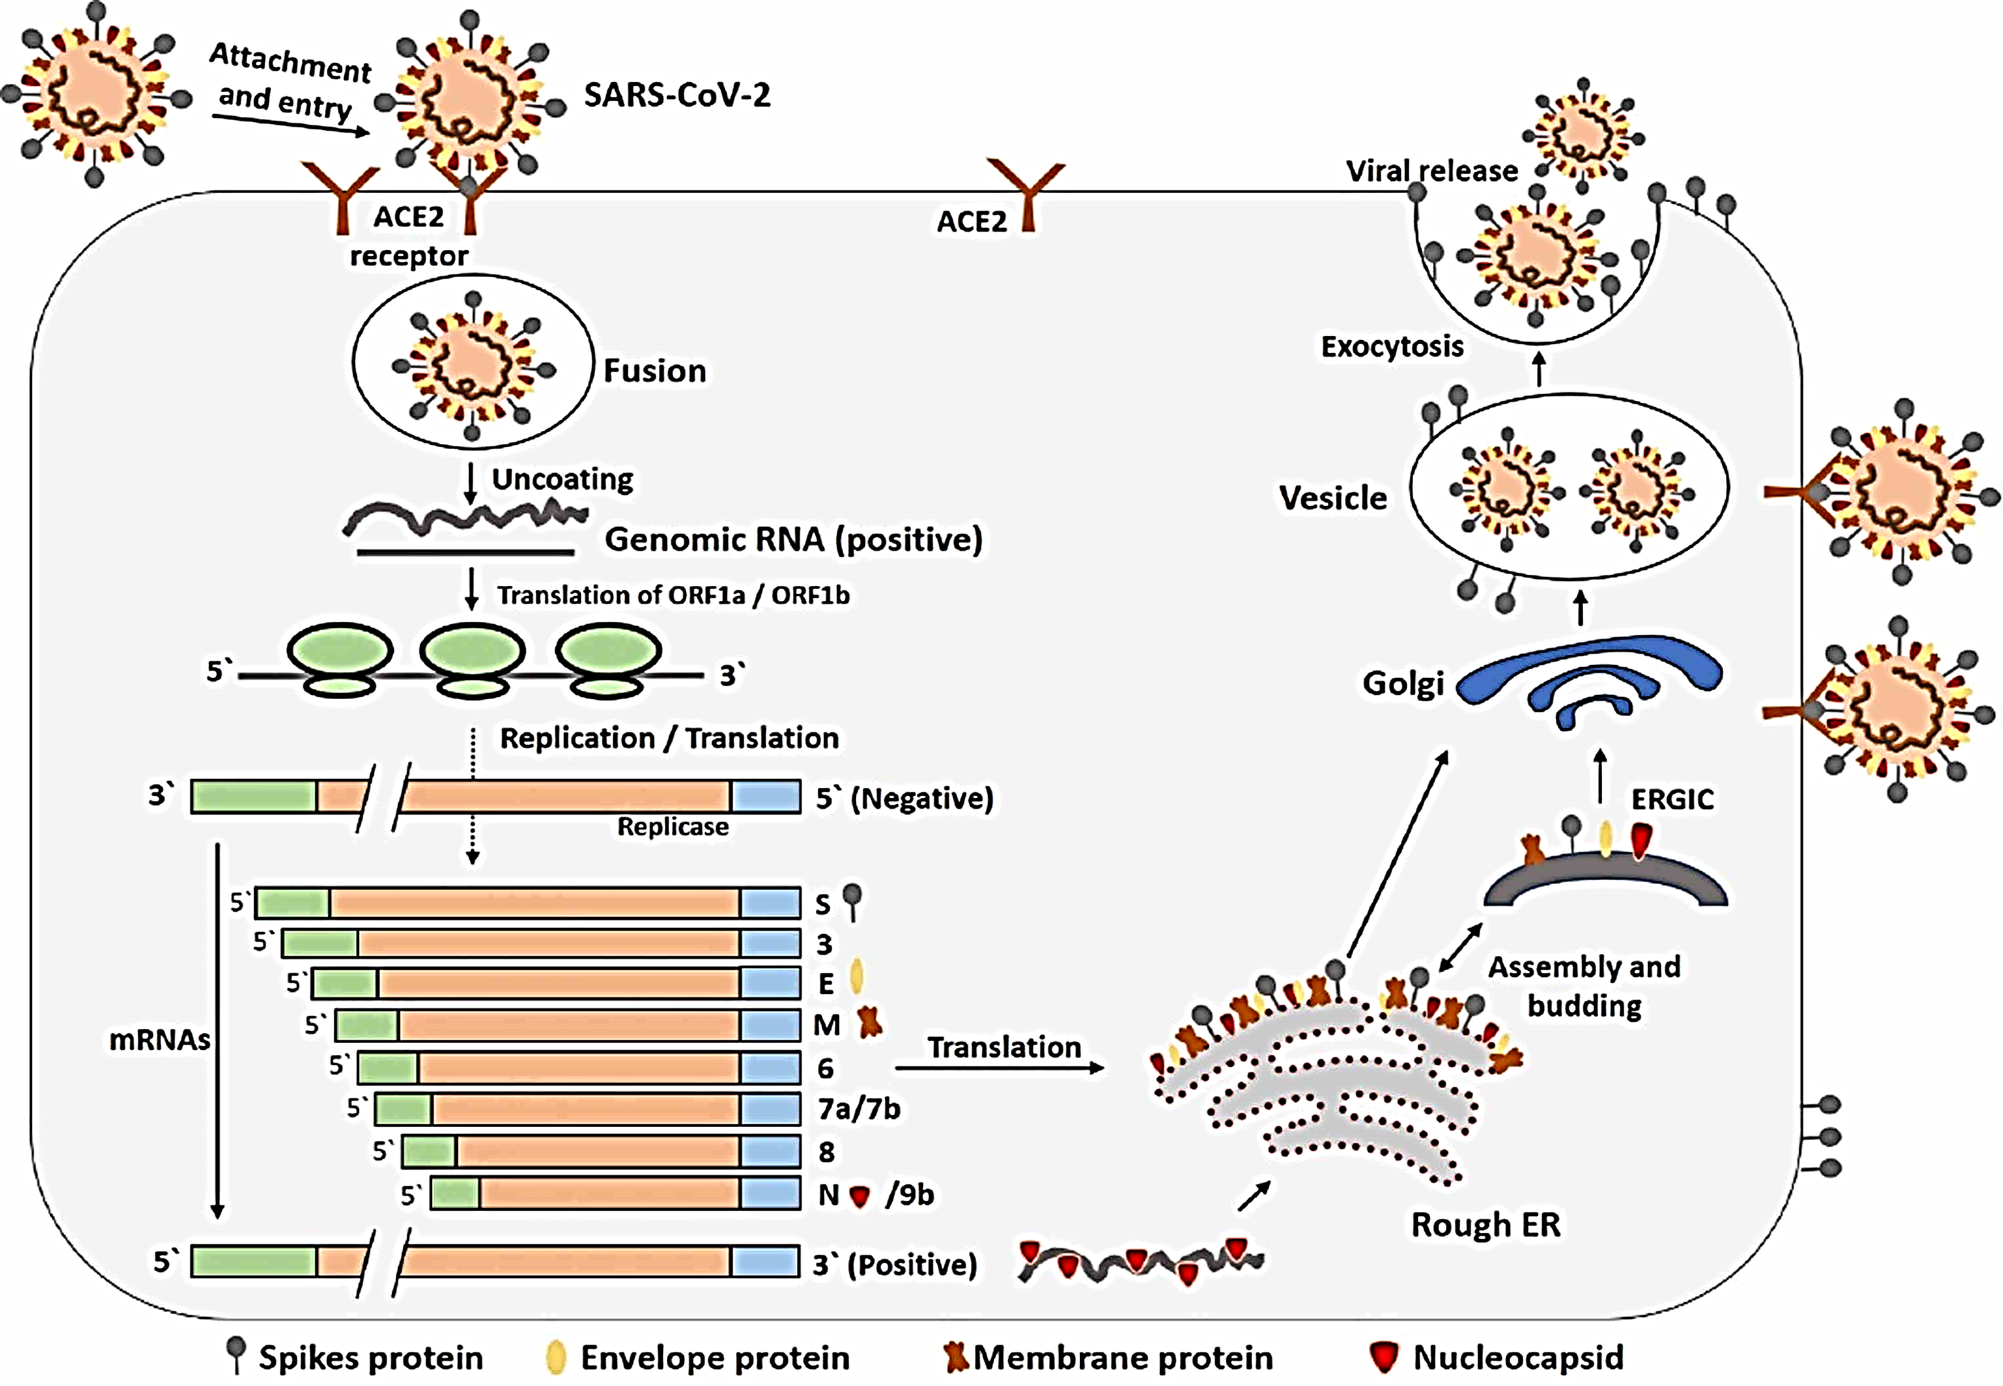
Pathophysiology

Slide 27
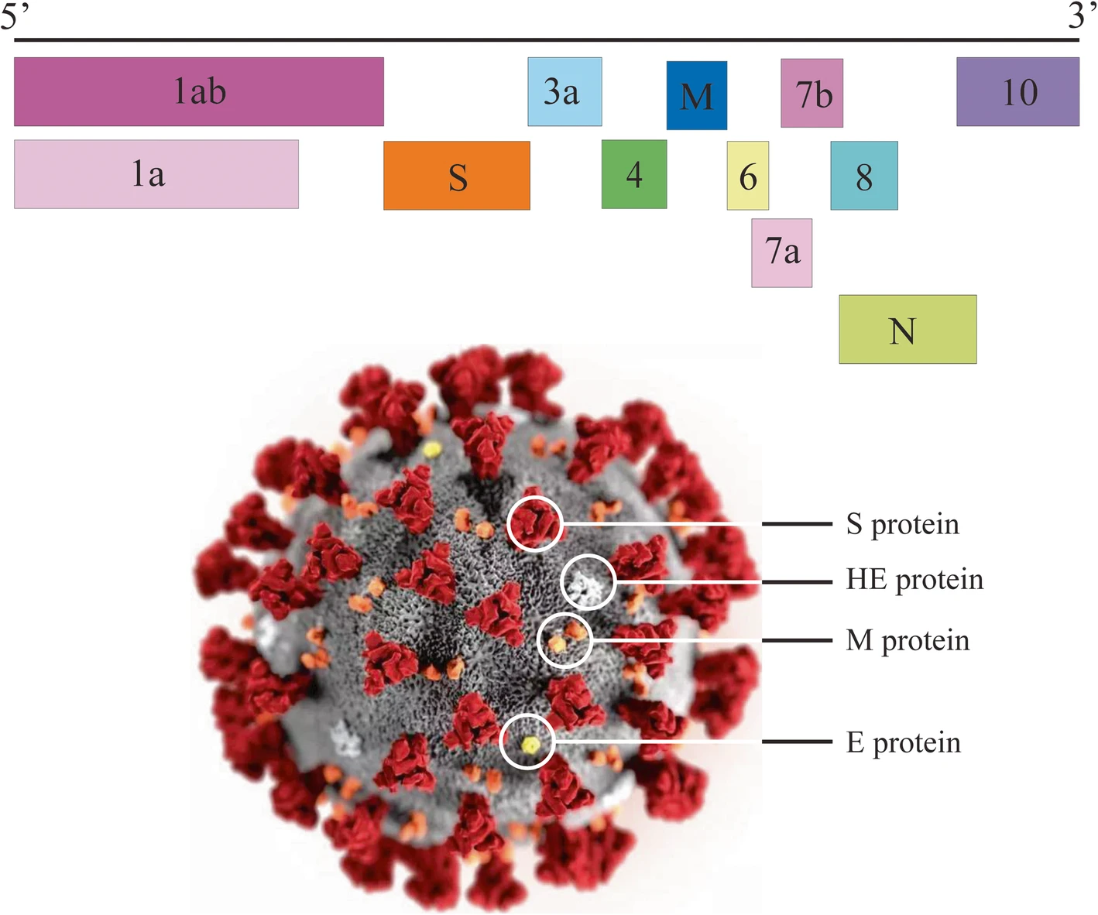
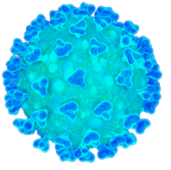
Virology
Severe acute respiratory syndrome coronavirus 2 (SARS-CoV-2) is the strain of coronavirus that causes coronavirus disease 2019 (COVID-19), the respiratory illness responsible for the COVID-19 pandemic.
Colloquially known as simply the coronavirus, it was previously referred to by its provisional name, 2019 novel coronavirus (2019-nCoV), and has also been called human coronavirus 2019 (HCoV-19 or hCoV-19).
SARS-CoV-2 is a Baltimore class IV positive-sense single-stranded RNA virus that is contagious in humans.

Slide 28
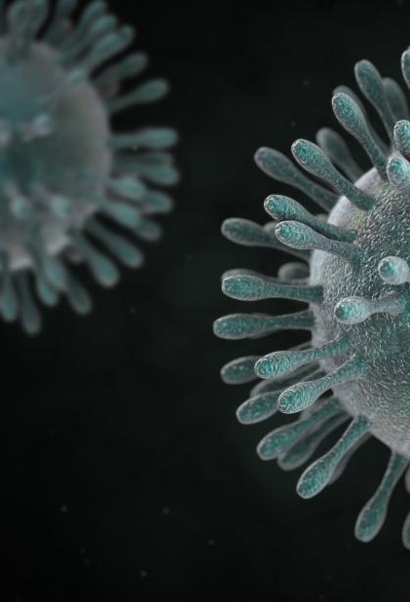
Human strains of the
Corona Virus
Human coronavirus 229E (HCoV-229E)
Human coronavirus OC43 (HCoV-OC43)
SARS-CoV
HCoV-NL63, New Haven coronavirus
Human coronavirus HKU1
MERS-CoV
Novel coronavirus (2019-nCoV) also known as SARS-CoV-2

Slide 29
The phylogenetic analysis revealed that COVID-19 is potentially a zoonotic virus.
Special attention is necessary to protect or reduce transmission in susceptible populations.
COVID-19 develop intestinal symptoms like diarrhea, while low percentage of MERS-CoV or SARS-CoV patients had diarrhea.

Slide 30
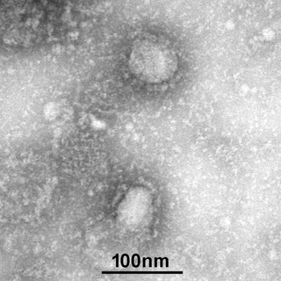
Electron micrograph of two
SARS-CoV-2

Slide 31
Severe Acute Respiratory Syndrome (SARS)
The SARS outbreak occurred in 2002-2003
During the SARS outbreak, China had 5,327 cases and 349 deaths (9.4%)
The last case of SARS occurred in 2004.

Slide 32
Middle East Respiratory Syndrome (MERS)
In September 2012, Middle East respiratory syndrome coronavirus (MERS-CoV) was first discovered in Saudi Arabia.
As of December 2019, 2,468 cases of MERS-CoV infection had been confirmed globally.

Slide 33
On February 11, 2020, the International Committee on Taxonomy of Viruses, named the novel coronavirus as
Severe Acute Respiratory Syndrome Coronavirus 2, shortened to SARS-CoV-2.

Slide 34

Virus | SARS-CoV-2
Genus | Beta coronavirus
Family | Coronaviridae
Envelop | Enveloped
Genome | Positive-sense single-stranded RNA genome
Genomic size | 26 to 32 kilobases

Slide 35
As described by the U.S. National Institutes of Health, it is the successor to SARS-CoV-1, the strain that caused the 2002–2004 SARS outbreak.
It is believed to have zoonotic origins and has close genetic similarity to bat coronaviruses, suggesting it emerged from a bat-borne virus.
There is no evidence yet to link an intermediate animal reservoir, such as a pangolin, to its introduction to humans. The virus shows little genetic diversity, indicating that the spillover event introducing SARS-CoV-2 to humans is likely to have occurred in late 2019.
On 3 July 2020, scientists reported finding that a major genetic risk factor for human infection with SARS-CoV-2 was inherited from archaic Neanderthals 60,000 years ago.

Slide 36
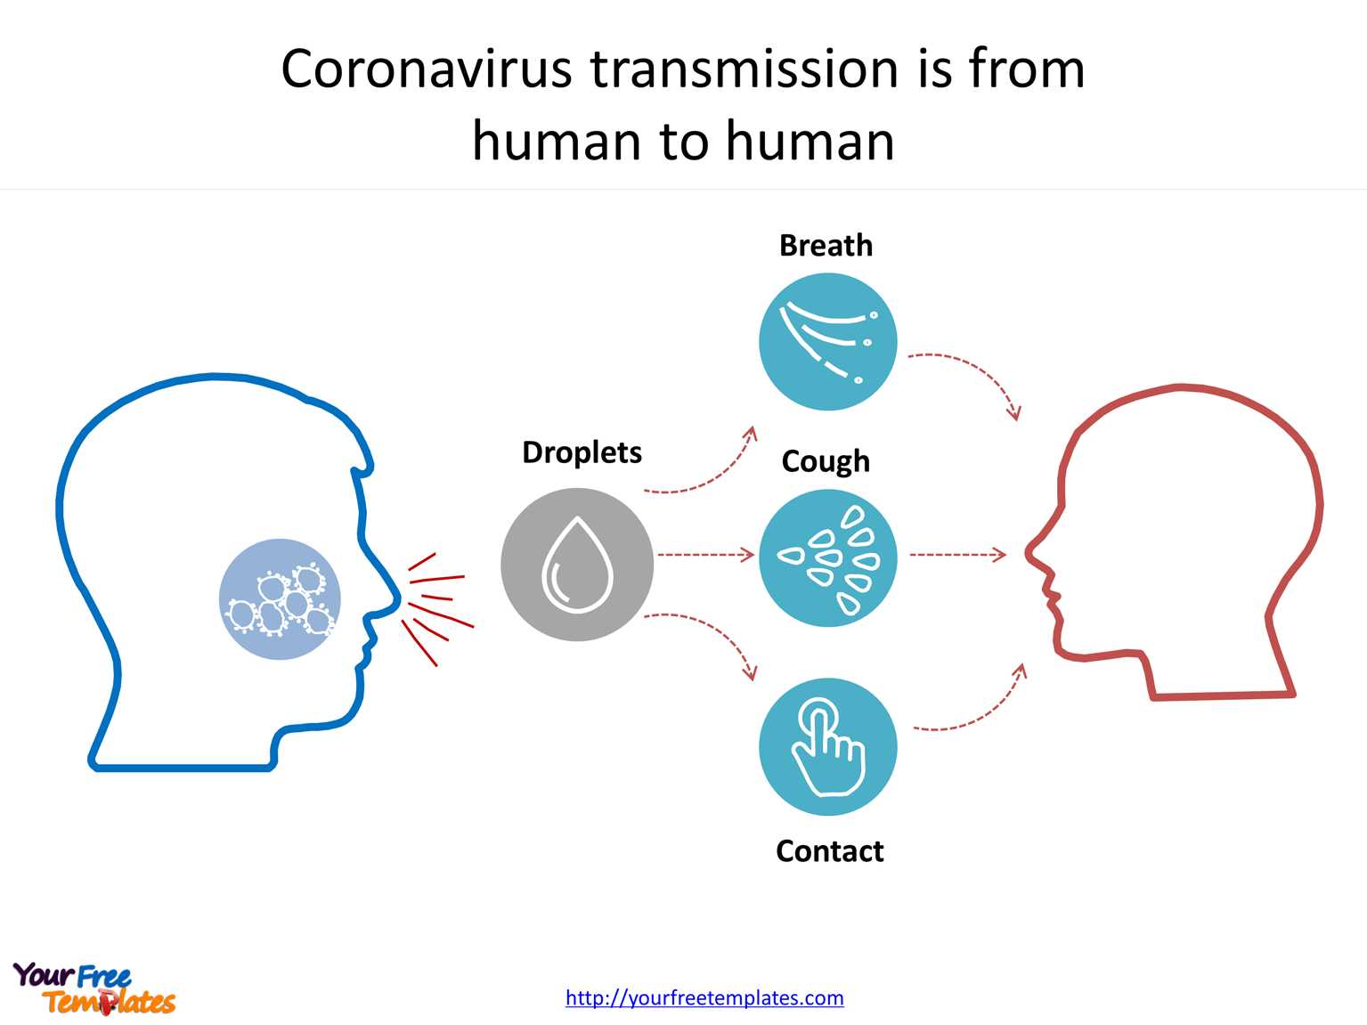
Transmission

Slide 37
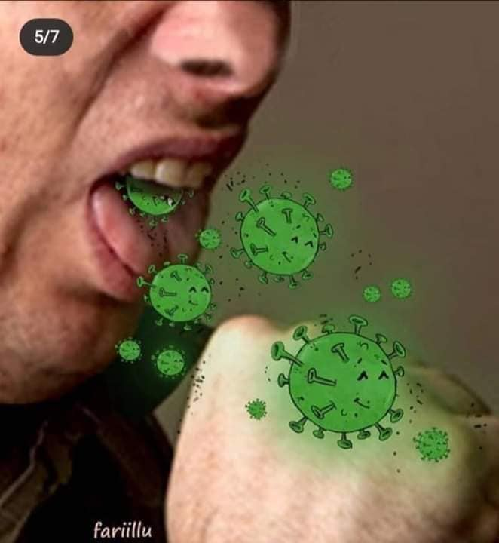
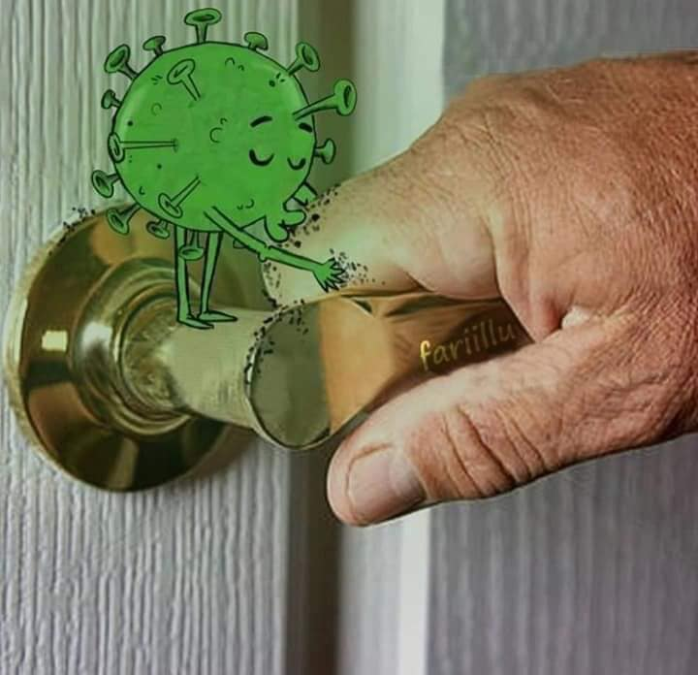
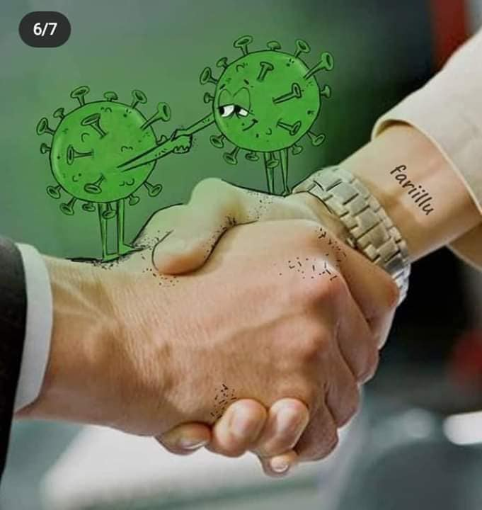

Slide 38
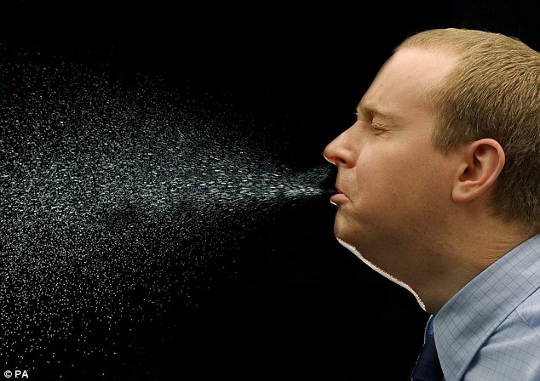
Human to Human transmission
Direct transmission:
Through droplets, ex- coughing and sneezing.
And close contact with oral and respiratory secretions, etc.

Slide 39
Incubation period
The WHO reported an incubation period for COVID-19 between 2 and 14 days.
China’s National Health Commission (NHC) had initially estimated an incubation period from 10 to 14 days.

Slide 40


Slide 41
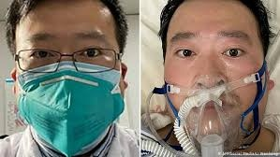
Who is this Doctor?
Young Chinese Doctor Li Wenliang, who was the first raised voice over Coronavirus, Died From the Disease.

Slide 42
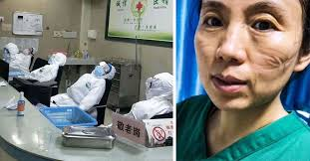
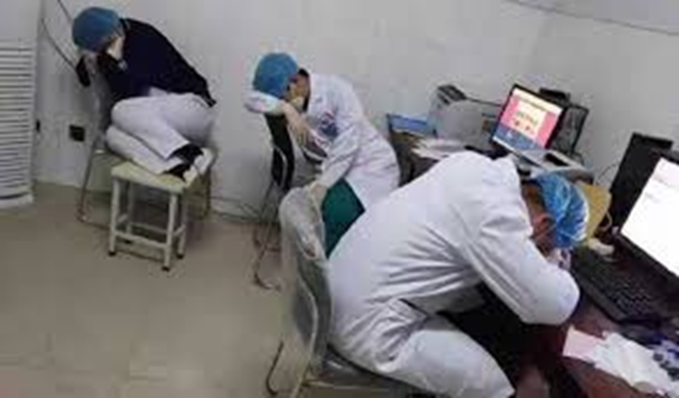
Exhausted Doctors & Nurses

Slide 43
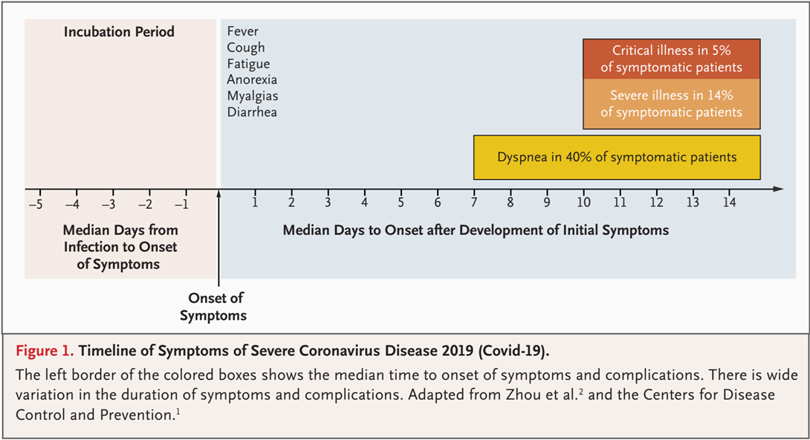
Timeline of Symptoms

Slide 44
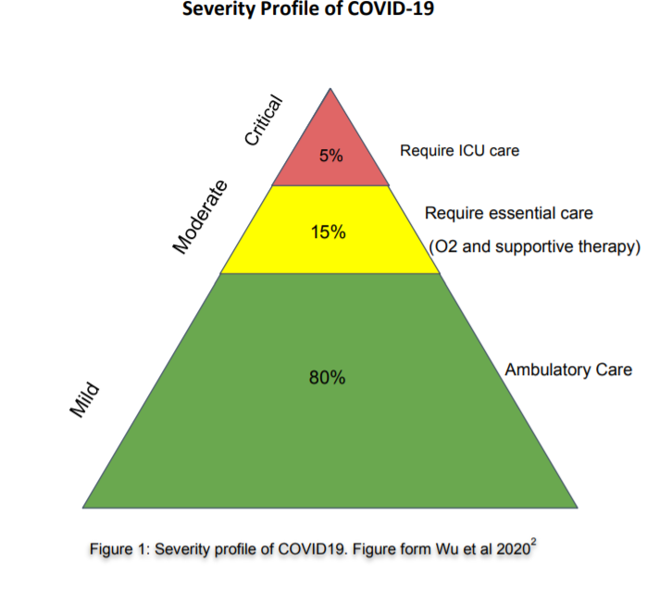

Slide 45


Slide 46

Case Definition
Suspect
Probable
Confirmed

Slide 47
Suspect Case
Acute respiratory illness, AND H/O travel to or residence in a country with COVID-19 disease during last 14 days.
OR,
Any acute respiratory illness AND contact with confirmed or probable COVID-19 case during last 14 days.
OR,
Severe acute respiratory illness AND no alternative diagnosis.

Slide 48
Probable Case
Suspect with inconclusive COVID-19 test
OR,
Suspect, COVID-19 test could not be done.

Slide 49
Confirmed Case
Case with laboratory confirmation of COVID-19 infection

Slide 50
Who is Contact?
No symptoms, but exposed to probable or confirmed case within 2 days before and 14 days after onset of symptoms.
Contact pattern
  - Face-to-face contact within 1 meter and for >15 minutes
  - Direct physical contact
  - Direct care of COVID-19 patient without proper PPE.

Slide 51
Clinical Presentation

Slide 52
Disease Manifestations
Asymptomatic (5%-80%)¹ In USA 40% ( The Mirror, 13 June)
Presymptomatic^{2,3}
  - Initially asymptomatic (1-3 days), later develops symptoms
  - Accounts for 6%-12% disease transmission
  - To prevent transmission, limiting contacts may not be enough
  - Supports social distancing, wearing surgical masks at population level.
Symptomatic
1. https://www.cebm.net/covid-19/covid-19-what-proportion-are-asymptomatic/
2. Wei WE, et al. MMWR Morb Mortal Wkly Rep. 2020 Apr 1. doi: 10.15585/mmwr.mm6914e1
3. Qian G, et al. Clin Infect Dis2020;ciaa316. doi:10.1093/cid/ciaa316

Slide 53
Clinical Features
Cough and shortness of breath or difficulty breathing plus at least 2 may indicate COVID-19 (not always applicable)
Fever Chills Repeated shaking with chills Muscle pain | Headache Sore throat New loss of taste or smell
CDC. Symptoms of Coronavirus. CDC. Available at https://www.cdc.gov/coronavirus/2019-ncov/symptoms-testing/symptoms.html. March 20, 2020; Accessed: April 28, 2020.

Slide 54
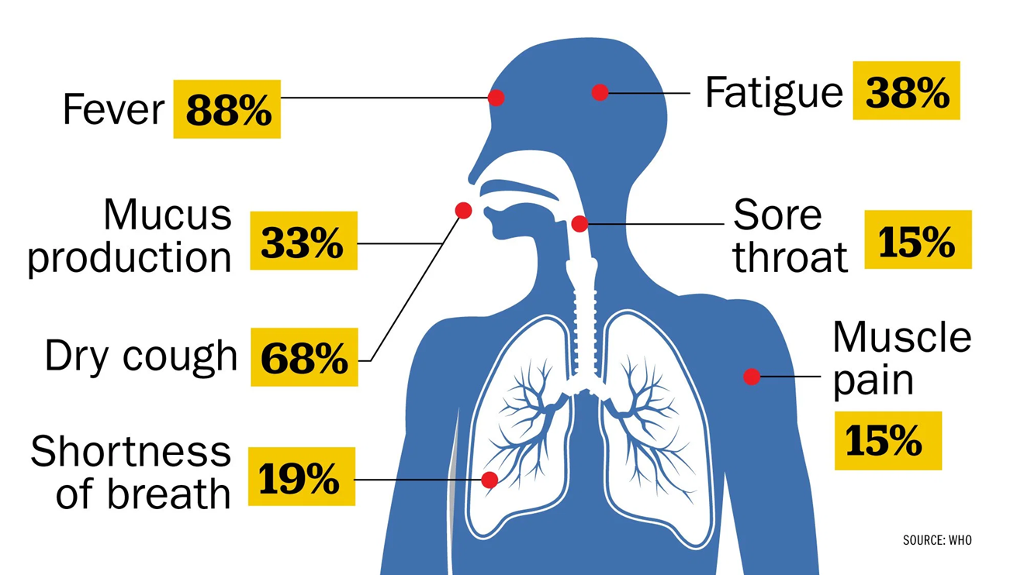
According to a study of nearly 56,000 laboratory confirmed cases cited in the WHO report, the most common symptom, experienced by 88% of confirmed patients, is a fever.

Slide 55
Symptoms of Patients (All 3 Hospitals; N-236)
Islam QT, Hossain HT, Fahim FR, Rashid M , Clinico-demograhic profile, treatment outline and clinical outcome of 236 confirmed hospitalized covid- 19 patients: a multi-centered descriptive study in dhaka, bangladesh; bjm 31:2,2020

Slide 56
Distribution of Patients according to Gender in Percentage

Slide 57
Distribution of Patients according to Age (All 3 Hospitals; N-236)

Slide 58
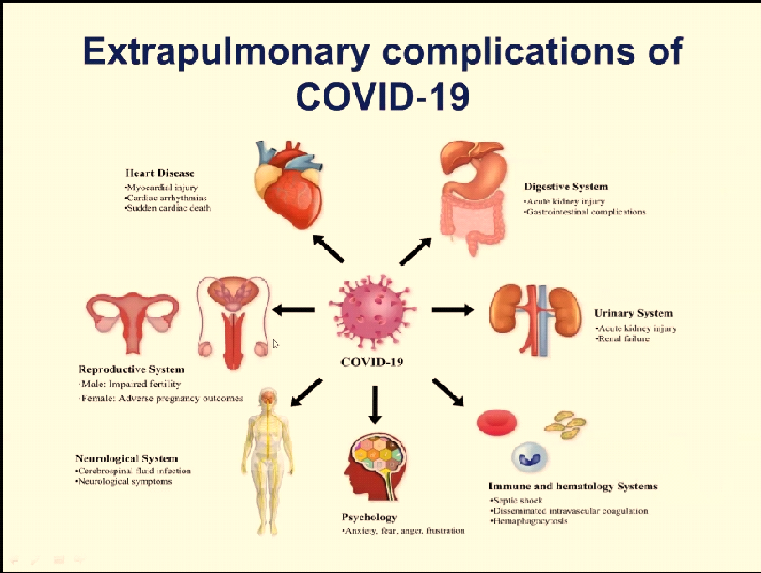

Slide 59
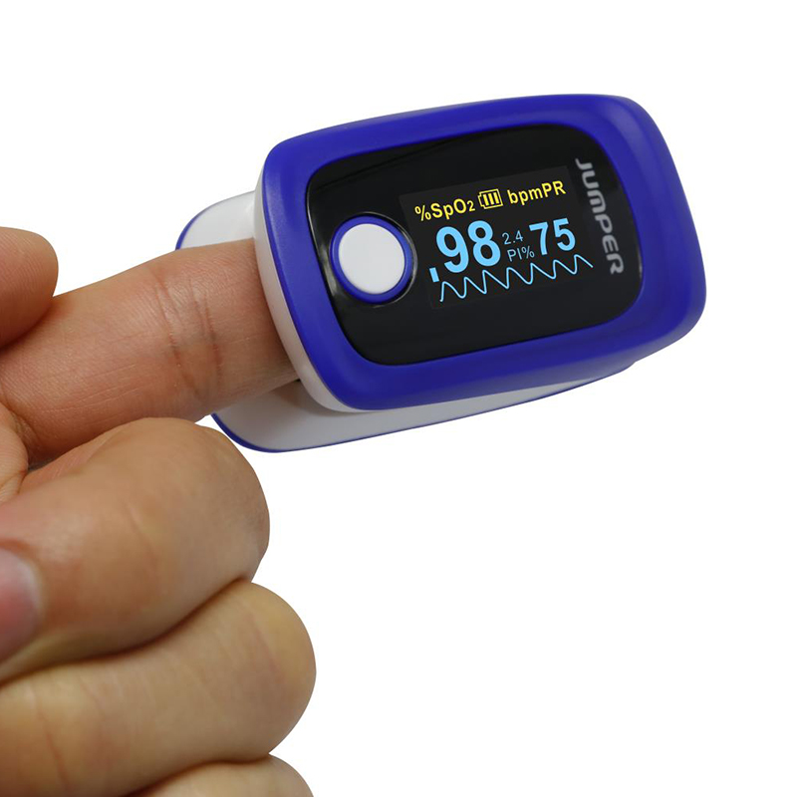
Check at Home
Patient may not feel SOB in the early stage of the disease though there is hypoxia- known as Happy Hypoxia.
Those who could not be diagnosed between 8-10 days that they have bi lateral lung infiltrates, their course of the disease and prognosis goes worst.
These group of patients proceeds to Severe /Critical.

Slide 60
High-Risk Features
Age ≥65 years
Nursing home or long-term care facility resident
Cardiac: Heart disease with complications
Immunocompromised: Including cancer treatment
Severe obesity: BMI ≥40
High risk Pregnancy
Comorbidities: Diabetes, renal failure, liver disease, HTN, Lung diseases
Centre for Disease Control, USA

Slide 61
Comorbidities of Patients (All 3 Hospitals; N-236)
Islam QT, Hossain HT, Fahim FR, Rashid M , Clinico-demograhic profile, treatment outline and clinical outcome of 236 confirmed hospitalized covid- 19 patients: a multi-centered descriptive study in dhaka, bangladesh; bjm 31:2,2020

Slide 62
Spectrum of Clinical Syndromes
Associated with COVID-19 Infection
Mild illness(ILI)
Pneumonia (Moderate)
Severe Pneumonia
Acute Respiratory Distress Syndrome
Sepsis
Septic shock

Slide 63
Severe Pneumonia
Fever or suspected RTI, plus one of :
  - Respiratory rate >30/min.
  - Severe respiratory distress; or
  - SpO₂ ≤93% on room air.

Slide 64
Acute Respiratory Distress Syndrome (ARDS)
Acute onset (within 1 week)
Bilateral opacities on chest imaging (e.g., x-ray)
Impaired oxygenation: PaO₂/FiO₂ ≤300 mmHg
If no risk factors for ARDS, acute left ventricular failure should be ruled out.
ARDS Definition Task Force, Ranieri VM, et al. JAMA. 2012 Jun 20;307(23):2526-33.

Slide 65
ARDS: When to suspect?
Critically ill patient if having…..
              - Dyspnoea, tachypnoea but
              - Chest auscultation normal.
Udobi KF, et al. Am Fam Physician. 2003 Jan 15;67(2):315-22.

Slide 66
Sepsis: Life-threatening organ dysfunction by dysregulated host response to infection
Signs of organ dysfunction:
Laboratory evidence:
Altered mental status
Difficult or fast breathing
Low oxygen saturation
Reduced urine output
Tachycardia, small volume pulse, cold extremities or low BP, skin mottling
Coagulopathy
Thrombocytopenia <50,000/cmm
Raised serum lactate
Hyperbilirubinemia

Slide 67
Septic Shock
Persisting hypotension despite volume resuscitation, requiring vasopressors to maintain MAP ≥65 mmHg and
Serum lactate level >2 mmol/L persisting after adequate fluid resuscitation. Needs Ventilator Support
Shankar-Hari M, et al., Sepsis Definitions Task Force. JAMA. 2016 Feb 23; 315(8):775-87.

Slide 68
ICU and Ventilator Mortality Among Critically ill Adults With Corona virus Disease 2019- study report
217 critically ill patients (March 6 to April 17), Atlanta, Georgia
Median Age 64(54-73) 1/4th cases were more than age 75 years
Commonest co-morbid conditions HTN(61.7%),DM (46.55%)
Median SOFA score was 7, Initial score > 11 (90%) mortality
Median D-dimer was 1731ng/ml (< 300)
Median CRP was 190 (<10)
75% patients received invasive ventilation

Slide 69
65% patients received Vasopressor for combating shock and 30% got RRT, 1.8% received ECMO
ICU mortality was 40%, Hospital mortality was 35.7%.
Significant association of mortality: Older age, Lower BMI, CKD, higher (SOFA score, CRP, D-dimer)
Needs mechanical ventilation ,Vasopressor and RRT
No difference of survival between patients received or not received Ramdesivir

Slide 70
Early intubation and standard lung protective ventilation strategies is useful.
2/3rd cases can be saved even those who require invasive mechanical ventilation.
ICU and Ventilator Mortality Among Critically Ill Adults With Coronavirus Disease 2019. M W. Adelman, S Arno, S C. Auld, T Barnes, W Bender, J M. Blum, G Budhrani, S Busby et al ; Crit Care Med. 2020 May 26

Slide 71


Slide 72
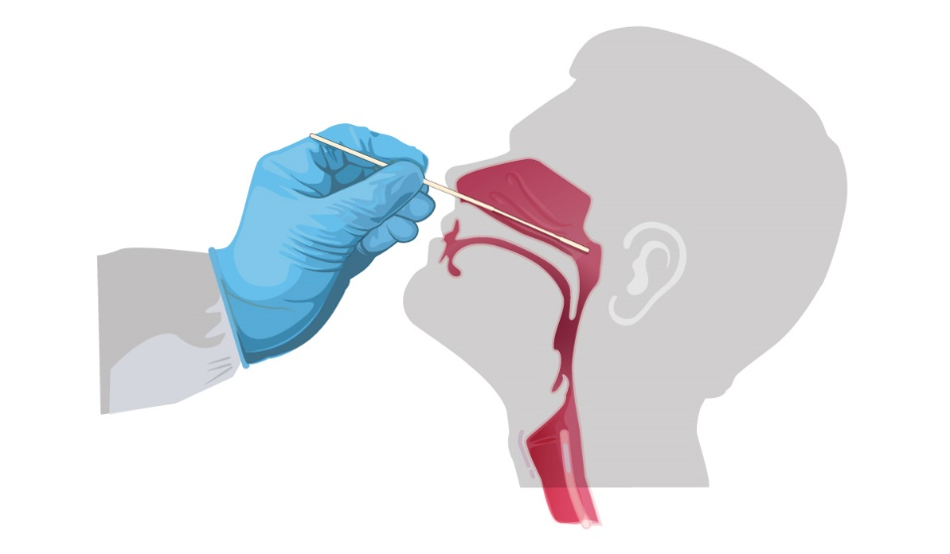
Investigations

Slide 73
Real-time RT-PCR Test for SARS-CoV-2
All suspects should have RT-PCR
Gold standard
High specificity, low sensitivity (65-95%)
Specimen:
  Upper airway specimens: Nasopharyngeal swab (first choice), oropharyngeal swab
  Lower airway specimens: Bronchoalveolar lavage, tracheal aspirate, pleural fluid, lung biopsy, sputum

Slide 74
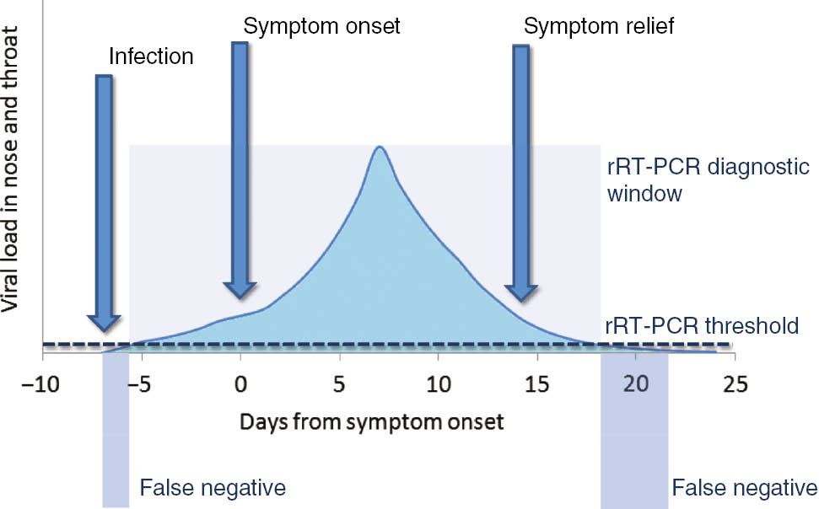
RT-PCR for SARS-CoV-2
Correspondence between viral load,
disease progression and RT-PCR
RT-PCR in 56 confirmed COVID- 19
patients in China
Week | Positivity
1 | 100%
2 | 89.3%
3 | 66.1%
4 | 32.1%
5 | 5.4%
6 | 0%
Xiao AT et al. Clin Infect Dis. 2020 Apr 19. pii: ciaa460. doi: 10.1093/cid/ciaa460.
Lippi G, et al. Clin Chem Lab Med. 2020 Mar 16. pii: /j/cclm.ahead-of-print/cclm-2020-0285/cclm-2020-0285.xml.

Slide 75
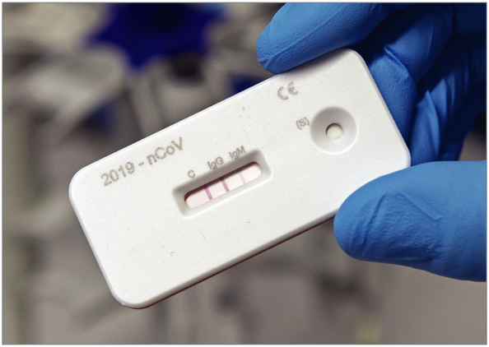
Serological Tests for SARS-CoV-2
Still evolving
Low sensitivity, good specificity
Still not recommended by WHO
CDC, USA has granted EUA
May be important for sero-surveillance
Gonoshasthaya's Rapid Dot Blot testing kit is under trial by ICDDR,B

Slide 76
Other Investigations
Blood tests:
  CBC: Lymphopenia;
  N:L >3.5 bad prognosis
  CRP: Raised
  Serum procalcitonin: Normal
  Serum ferritin: Raised
  Serum LDH: Mildly raised
  Serum D-dimer: Raised
Imaging: Atypical pneumonia
          Chest x-ray
          HRCT scan of chest
          USG of chest
Serological tests for SARS-CoV-2
          Still evolving
Viral culture

Slide 77
Investigations
PCR for COVID19-Posit/Neg/False/True/Repeat/Duration of posit
CBC - Count of WBC/NLR ratio
CXR - When/Role/Limitation/Advantage
HRCT Chest -When/Role/Importance/Advantages/Disadvant
CRP - Usefulness/Interpretation/Decision

Slide 78
Investigations
FERRITIN Usefulness/Interpretation/Decision/cut off value for aggressive treatment
D-dimer - Usefulness/Interpretation/Decision
LDH - Usefulness/Interpretation/Decision
PROCALCITONIN - Indication/Interpretation/Decision
LACTATE - Indication/Interpretation/Decision

Slide 79
Investigations
Rapid Antigen Test
Antibody Test
Creatinine
ALT/AST
ABG
Electrolyte
Blood C/S

Slide 80
Investigations
Fiction
Fact
A positive RT-PCR means the infectious virus is present in the body
A negative RT-PCR is enough to declare someone as Covid negative
A positive RT-PCR result doesn’t prove that replicating (also called infectious or viable) virus is present. It proves that its genetic material – the RNA – is present.
RT-PCR for Covid is only 65% sensitive. This means 35 out of 100 patients who have the virus will be tested RT-PCR negative. Imaging and other markers with clinical presentation is used to diagnose RT-PCR negative Covid-19

Slide 81
RT-PCR for COVID 19
67% Sensitivity
91% Specifity
Every Third patient will be negative with potential positivity

Slide 82
False-positive results are more likely when the prevalence of SARS-COV-2 is moderate to low, and can be caused by cross-reaction with antibodies formed by current and past exposure to seasonal human PAN corona infections (eg:common cold).
World Health Organization does not recommend the use of rapid point-of-care tests outside of research settings as they have not been validated as yet. ( Rapid antigen Test)

Slide 83
CT Scan of Chest
Should not be relied upon for diagnosis and screening
High sensitivity (94%) but low specificity (37%)
Commonest: Ground-glass opacities -- bilateral, subpleural, peripheral
Others:
  Crazy paving appearance (ground-glass opacities plus inter-/intra-lobular septal thickening)
  Consolidation
  Vascular dilatation
  Traction Bronchiectasis
  Subpleural bands and architectural distortion
https://radiologyassistant.nl/chest/lk-jg-1

Slide 84
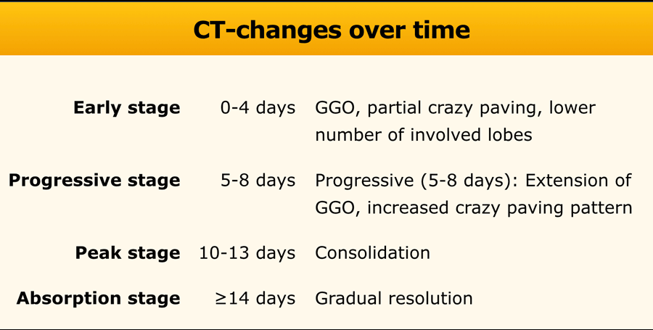
https://radiologyassistant.nl/chest/lk-jg-1

Slide 85
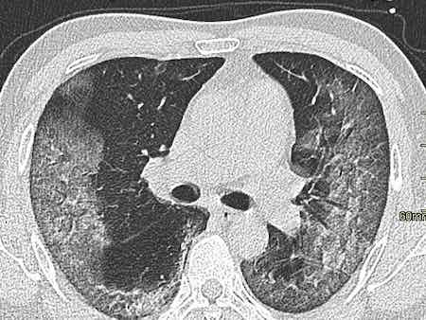
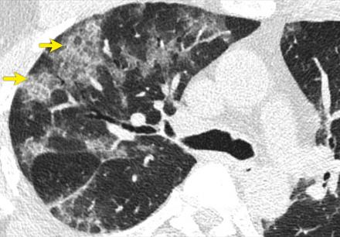
CT scan of chest in COVID- 19
Ground glass opacity
Crazy paving
https://radiologyassistant.nl/chest/lk-jg-1

Slide 86
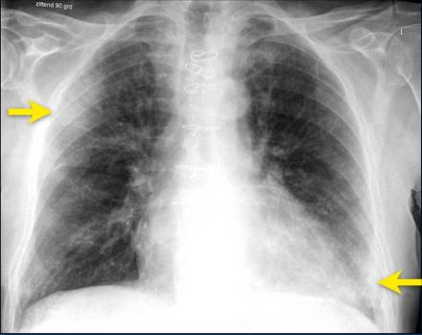
Chest x-ray
Typically, first-line imaging modality
Less sensitive than CT scan of chest
Commonest: Consolidation
Less common: Ground glass opacity
Bilateral, peripheral, lower zone predominant
Pleural effusion rare.
Ground-glass opacification and consolidation in
right upper lobe and left lower lobe (arrows).
https://radiologyassistant.nl/chest/lk-jg-1

Slide 87
Chest x-ray in COVID- 19
Bilateral pneumonia
ARDS
National Guidelines on Clinical Management of Coronavirus Disease 2019(Covid-19), Version 5.9 April 2020, Government of the People's Republic of Bangladesh.

Slide 88
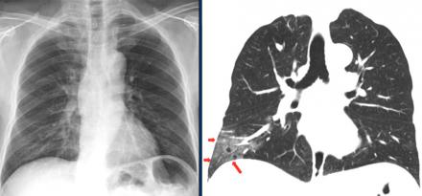
CXR vs. CT scan of Chest
Ground glass opacities in right lower lobe on CT (red arrows) are not
visible on chest radiograph, which was taken 1 hour prior to CT-study.
https://radiologyassistant.nl/chest/lk-jg-1

Slide 89
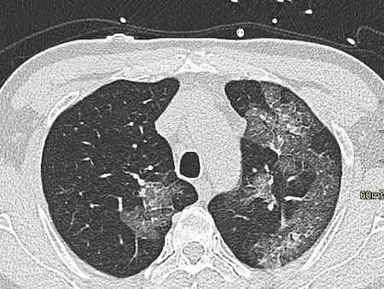
HRCT Findings
Ground Glass

Slide 90

Crazy paving

Slide 91
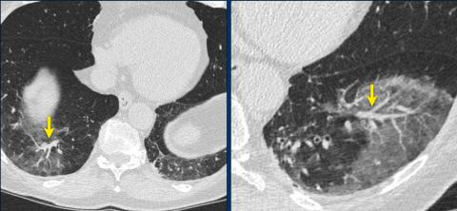
Vascular Dilatation

Slide 92
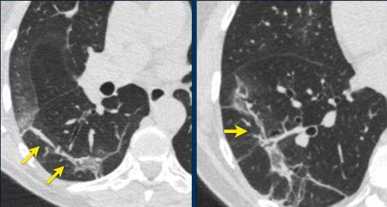
Subpleural bands and Architectural distortion

Slide 93
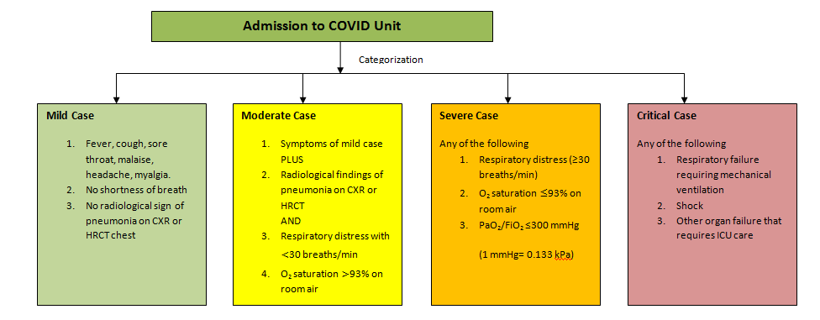
Admission to COVID Unit

Slide 94


Slide 95


Slide 96
Management

Slide 97
DATA
42 yrs male, non diabetic , non hypertensive , PCR positive
CRP – 216
D- dimer – 0.4/ 0.5
Ferritin – 6572
HRCT Chest – 75% involved
LDH – 784
Procalcitonin – 1
Lactate – 43
Spo2 - 94-95% with 12 – 15 L Oxygen
WBC- 37.2 K/L N – 88%

Slide 98
DATA
58 yrs woman, diabetic, PCR positive
HRCT Chest – 70% involvement
CRP-221 (10)
D-dimer – 9.86 (0.5)
LDH 430 (250)
Procalcitonin- 0.16
WBC – 7390,N-91%
Ferritin- 245
Spo2 – 82% with HFNC-50L= NRB mask- 15L

Slide 99
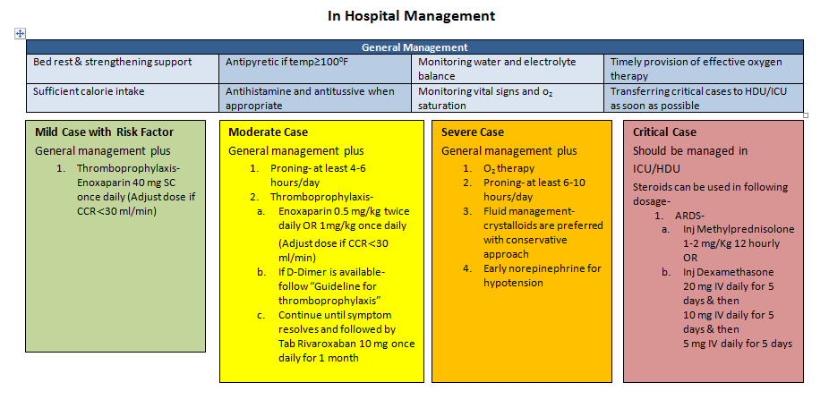
In Hospital Management

Slide 100
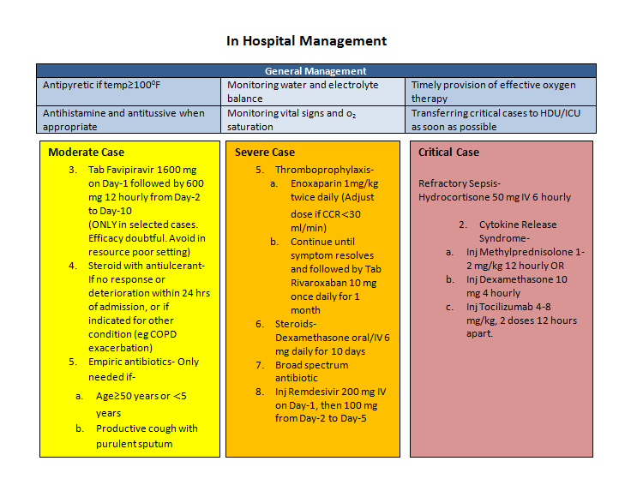
In Hospital Management

Slide 101
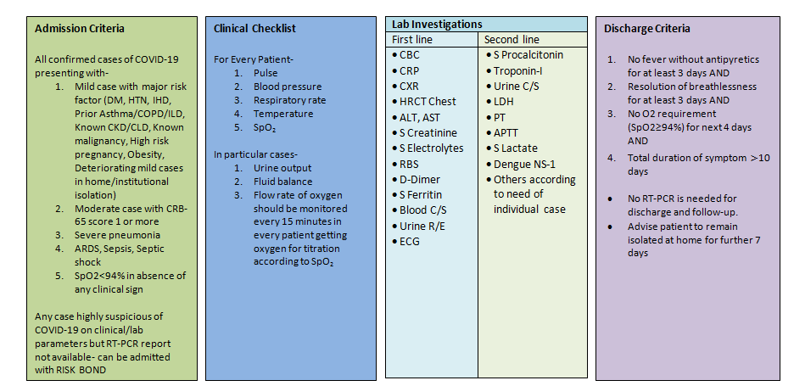

Slide 102
No specific treatment
Management mostly symptomatic & supportive

Slide 103
Clinical Criteria for Case Management
Stage of illness | Definition
Mild | Influenza like illness (ILI)
Moderate | Pneumonia (CRB 65 score 0)
Severe | Severe pneumonia, sepsis
Critical | ARDS, septic shock

Slide 104
Where to Manage?
Stage of Illness | Definition | Place of Care
Asymptomatic | No symptoms | Home, ?Tele- medicine
Mild | Influenza like illness (ILI) | Home
Moderate | Pneumonia (CRB 65 score 0) | Home
Severe | Severe pneumonia, sepsis | Hospital, preferably, HDU
Critical | ARDS, septic shock | Hospital, preferably, ICU

Slide 105
Management
Oxygen- Nasal Canula/FM/NRM/PAP/HFNC
Heparin- Unfractionated/LMW
DOAC - Dose/Duration/Situation
Antiviral - Types/Benefits/Risks/Outcomes/Costs

Slide 106
Management
Steroids- Types/Nature/Indications/Duration/Benefit/Risk
CP - Timing/Indication/advantages/Disadvantages
MAB - Indication/Contraindication/Risk/Benefit/Cost
PRONING- Suitability/advantage/Duration

Slide 107
Mild cases (Influenza-like illness)
Self-isolation at home (if not possible, institutional isolation)
Symptomatic treatment: Paracetamol, antihistamine
Azithromycin-500 mg once on D1, then 250 mg on D2 to D5.

Slide 108
Self-home isolation for 14 days after clinical recovery
When to seek hospital care?
              Respiratory distress
              Worsening cough and fever
              Altered mental status
              Extreme lethargy

Slide 109
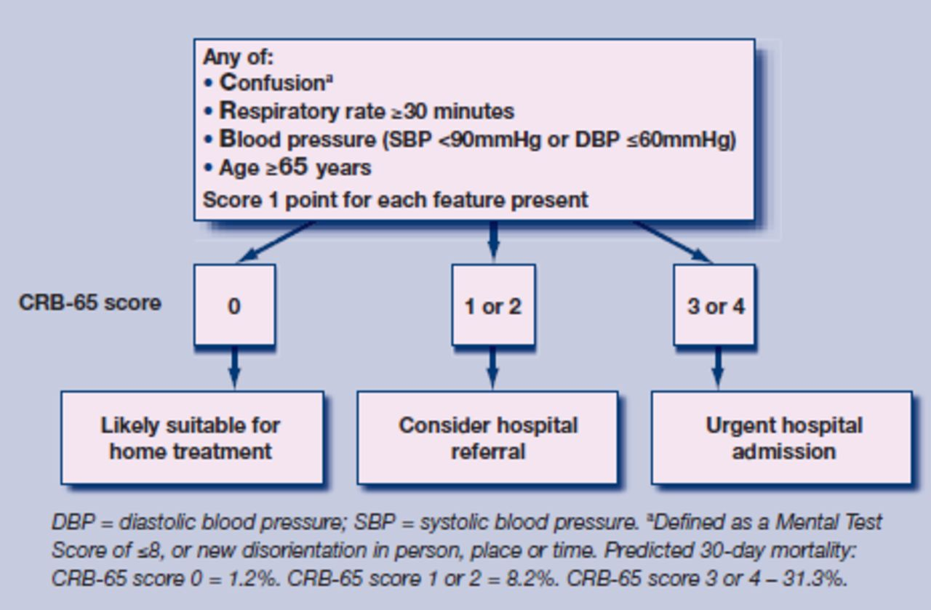
CRB 65 Scoring System

Slide 110
Moderate Cases (Pneumonia)
Treatment as for mild cases
PLUS
Oral antibiotics as for uncomplicated community acquired pneumonia
Favipiravir 1600 mg stat, 600 mg bd 7-10 days. Efficacy doubtful?
Thromboprophylaxis with LMW heparin ( 1 mg/kg BW)
DOAC – Rivaroxavan 10 / day 2 -4 weeks ( On discharge)

Slide 111
Severe Cases (Severe Pneumonia, Sepsis)
Supplemental oxygen: If SpO₂ <94%; respiratory rate >30/minute; shock
        Oxygen at 5 litres/min, titrated to target SpO₂ >94%
Empirical antibiotics
Inj. Dexamethasone 6-10 mg IV
Inj.Ramdisivir 200 mg stat, 100 mg daily -5 days
Thromboprophylaxis with LMW heparin ( 1 mg/kg BW bd)
Management of co-morbid conditions

Slide 112
Critical Cases (ARDS, Septic shock)
Ventilation:
  Immediate supplemental oxygen, if SpO₂ <94%; high flow nasal canula preferable
  Mechanical ventilation in prone position
Haemodynamic support: Target MAP of 60-65 mmHg.
  Conservative fluid strategy, crystalloids preferable
  Inotropes: norepinephrine (first line), vasopressin (second line)
Empirical antibiotics
Steroid, if septic shock, ARDS ( Inj. Dexamethasone 10 -20 mg/d)
Thromboprophylaxis with LMW heparin ( Full dose- 14 days)
DOAC 10 -20 mg /day for 2-3 months

Slide 113
COVID patient’s Oxygen Delivery Algorithm
Aim: SpO2 90-96%%
Device: Nasal prongs/ Face mask/ NRB Mask
Starts oxygen 2-6 l/min through nasal prongs
Asses response for 10-15min to keep Spo2 >90%
If increasing respiratory distress
or SpO2 < 90% (88% in COPD)
Starts oxygen 6-10 l/min through Face mask
Asses response for 10-15min to keep Spo2 >90%

Slide 114
If increasing respiratory distress or SpO2 <90% (<88% in COPD)
Start Proning breathing along with supplement oxygen 10-15 l/min through Face mask/NRB mask
Asses response for 10-15min to keep Spo2 >90%
If still increasing respiratory distress
or SpO2 <90% (<88% in COPD)
or patient is exhausted HFNC is urgently needed ( 40 -50L) /minute, if all these fail only then
Refer the patient to ICU for Ventilator assistance

Slide 115
Available Treatment
Remdesivir: FDA approved (available in Bangladesh)
Favipiravir: Available ( ? doubtful efficacy)
Convalescent plasma ( In use)
Tocilizumab ( specific indication of use) CRS

Slide 116
Treatment Provided (All 3 Hospitals; N-236)
Islam QT, Hossain HT, Fahim FR, Rashid M , Clinico-demograhic profile, treatment outline and clinical outcome of 236 confirmed hospitalized covid- 19 patients: a multi-centered descriptive study in dhaka, bangladesh; bjm 31:2,2020

Slide 117


COVID- 19 and Mental Health
A medical worker is seen sitting in the East Village of China during the coronavirus pandemic
Dr. Lorna M. Breen, medical director at NewYork-Presbyterian Allen Hospital, committed suicide.

Slide 118


Slide 119
Clinical Management and Admission criteria
Patients with a mild clinical presentation may not initially require hospitalization.
However, clinical signs and symptoms may worsen with progression to lower respiratory tract disease in the second week of illness.
• All patients should be monitored closely.

Slide 120
Evaluation of Patients
The decision to discontinue for hospitalized patients with COVID-19 should be made on a case-by-case basis in consultation with clinicians, infection prevention and control specialists, and public health officials.
disease severity,
illness signs and symptoms, and
results of laboratory testing for COVID-19 in respiratory specimens.
Decision will be taken by clinicians

Slide 121
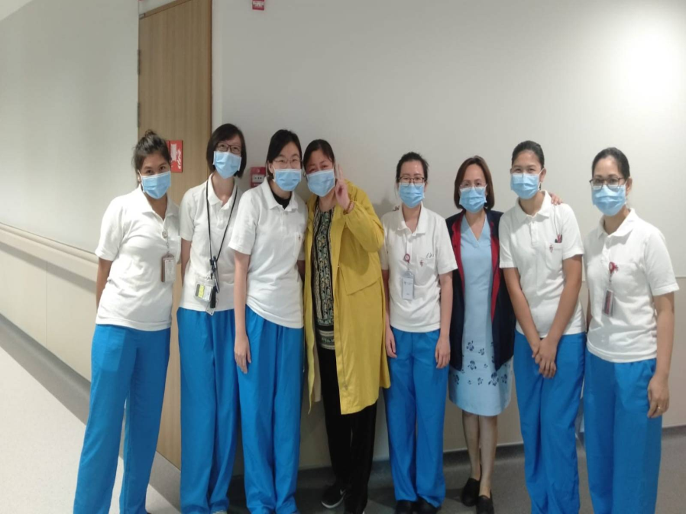
Discharge Criteria
• Resolution of fever, without use of antipyretic medication - for at least 2 days.
• Improvement in illness signs and symptoms.

Slide 122
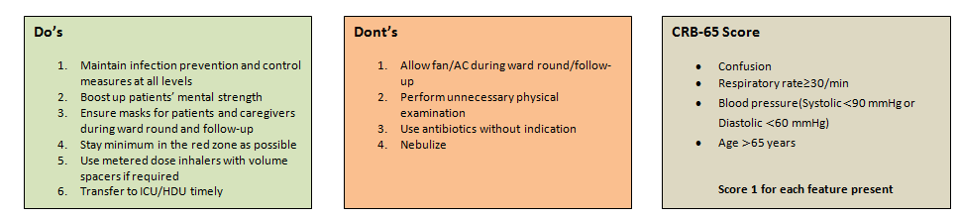

Slide 123
Take-Home Message
An RNA virus disease, mainly spread by respiratory droplets
Majority experiences mild to moderate respiratory illness
RT-PCR is the gold standard test
Management is symptomatic and supportive
Thromboprophylaxis for all hospitalized COVID- 19 patients
Remdisivir has EUA by FDA
Home management is for asymptomatic, mild and moderate diseases
Hospital management is indicated for severe and critical diseases
Vaccines are in up to phase 3 trial
Prognosis appears better than SARS, MERS, and Ebola.

Slide 124


Slide 125


Slide 126


Slide 127


Slide 128
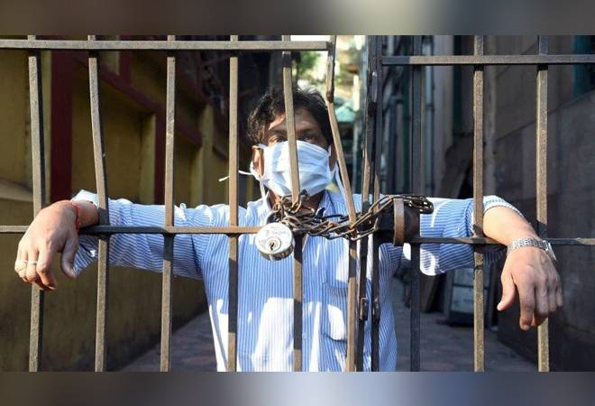

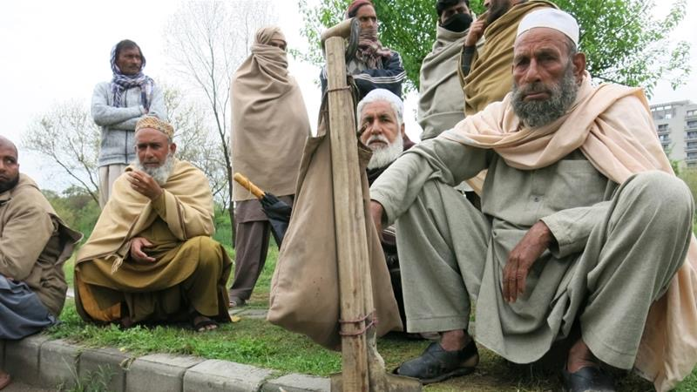

Thank you

